Slide 1

[ S-RANK ARTIFACT ]
WEB PILOT
Autonomous Web Agent
📢 [ SYSTEM ] A new S-Rank Quest has been registered. The Shadow Monarch's browser awaits activation.
Microsoft Build AI Hackathon 2026 · Nishchal Soni & Kuldeep Parmar

Slide 2

HACKATHON QUEST REGISTRY
Enter the Arena
⚠️ [ SYSTEM ALERT ] Only the strongest agents survive. Standard chatbots have been eliminated from consideration.
⚔️ Build AI Live Arena
🌐 Core Theme: Agentic Web
10,200+ Competitors Registered
100% Fully Autonomous Systems
Competing against top global builders in an intensive online system deployment phase — no warm-up rounds.
Tasked with building agents that navigate websites, plan dynamically, recover from errors, and clear complete workflows — zero human intervention.

Slide 3

THE PROBLEM
E-Rank vs S-Rank Execution
🚨 [ SYSTEM WARNING ] E-Rank AI performance detected. Initiating rank-up sequence...
✗ E-Rank AI Chatbot
✓ S-Rank WebPilot
Can only answer static QA prompts
Cannot navigate live visual web components
Navigates live production web spaces
Orchestrates deep multi-step missions
Fails completely at system form-fills
Requires heavy external supervision
Self-recovers and adapts on element shifts
Zero human hand-holding needed

Slide 4


[ STATUS WINDOW ]
WebPilot — Runtime Matrix
Agent Profile
Attribute Metrics
NAME: WebPilot
CLASS: Autonomous Web Agent
RANK: S
95%
Planning
Dynamic task decomposition
MISSION BRIEFING: Fulfills high-level web objectives seamlessly — no brittle API dependency trees, no custom scrapers. Give WebPilot a text statement, and it plans browser sequences dynamically.
90%
Execution
Native DOM interaction
✅ STATUS: AWAKENED — Ready for deployment
85%
Resilience
RANK COMPARISON DETAILS
Why the Gap is Unbridgeable
Self-recovery on element shifts
E-Rank systems rely on scripted pipelines with zero adaptability. A single DOM change breaks the entire workflow. S-Rank WebPilot uses LLM-driven dynamic planning — it re-routes like a Shadow Monarch adapting to a new dungeon floor.
98%
Autonomy
Zero human supervision required

Slide 5


THE SHADOW SYSTEM ARCHITECTURE
Four-Stage Execution Pipeline
🔮 [ SYSTEM ] Each stage represents a layer of the Shadow Army's command chain — from spoken word to structured conquest.
LLM Core Engine
Prompt Input
User defines the high-level task in plain language.
Dynamically plans and formats browser locator execution chains.
Playwright
Extraction
Interacts natively with real DOM elements in Chromium.
Extracts, filters, and formats clean structured payloads.
From natural language to structured output — WebPilot's shadow architecture eliminates manual orchestration at every layer of the stack.

Slide 6




[ DIVE DEEPER ]
Stage-by-Stage Breakdown
Prompt Input
LLM Core Engine
Plain English. No scripting. No XPath. Just intent.
GPT-4o plans the full browser action chain dynamically.
Playwright
Extraction
Executes real DOM interactions inside Chromium natively.
Clean structured payloads delivered — mission complete.

Slide 7


[ DEPLOYMENT CODES ]
Initialize the System
⚙️ [ SYSTEM ] Initiating Shadow Extraction Ceremony... Runtime environment activation in progress.
Terminal — Environment Setup
Runtime Stack
pip install playwright python-dotenv browser-use
playwright install chromium
OpenAI GPT-4o
Browser-Use
LLM brain for task planning & decision chains
High-level agentic browser abstraction layer
Core Runtime — Agent Bootstrap
from browser_use import Agent
agent = Agent(
task="Find the top 3 Python AI libraries on PyPI",
llm=llm,
browser_context=browser_context
)
await agent.run()
Playwright
Native Chromium DOM interaction engine
🟢 All systems online. Shadow Army ready for deployment.

Slide 8
[ UNLOCK: ADVANCED CONFIG ]
Optional Power Parameters
agent = Agent(
task="...",
llm=llm,
max_steps=25,
use_vision=True,
save_conversation_path="./logs"
)

Slide 9
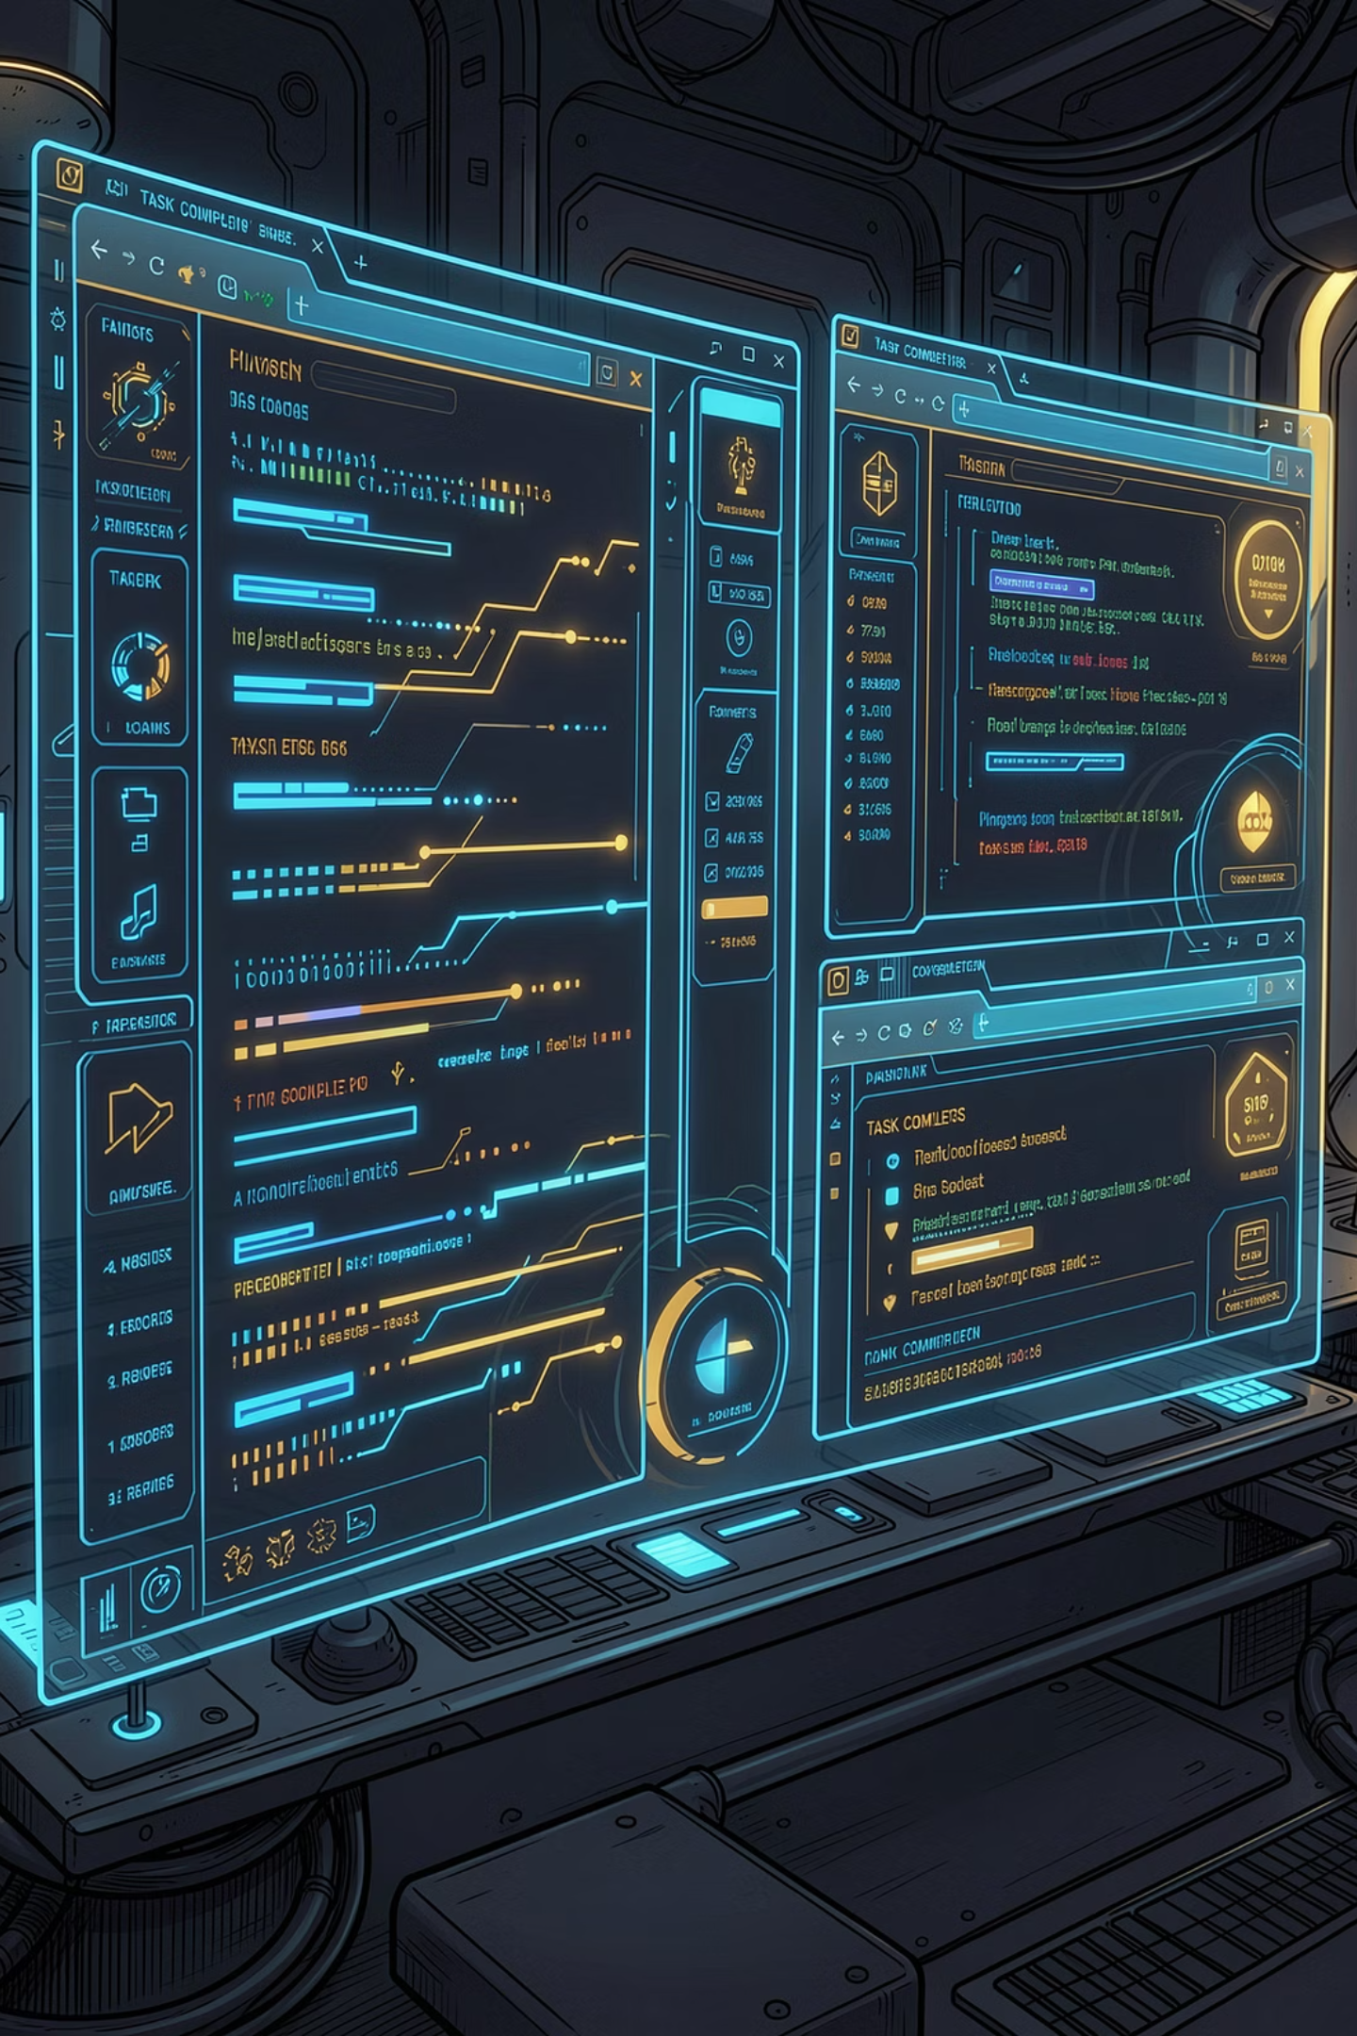

[ LIVE DEMO QUEST ]
WebPilot in Action
🔍 Research Mission
📋 Form Automation
Scrape & compare product pricing across live e-commerce sites
Complete multi-step registration workflows with dynamic field handling
📊 Data Extraction
Pull structured datasets from complex SPA layouts — no API required

Slide 10



[ QUEST LOG: MISSIONS CLEARED ]
Dungeon Clear Report
Research Mission
Form Automation
Data Extraction
Navigated 5 live e-commerce sites, extracted and ranked 50+ products by price — zero human input.
Completed a 7-step dynamic registration form including CAPTCHA handling — mission cleared.
Pulled structured JSON from a React SPA with infinite scroll — no API, no scraper, pure agent intelligence.

Slide 11




SYSTEM ADVANTAGES
Why WebPilot Dominates
Zero API Dependency
Self-Healing Execution
Operates on any live website — no custom integrations, no backend access needed
Adapts to DOM changes, pop-ups, and dynamic content in real time
Natural Language Input
Multi-Step Orchestration
Plain English task statements — no scripting, no XPath, no CSS selectors
Plans, executes, and validates complex workflows end-to-end autonomously

Slide 12

[ ROADMAP ]
System Evolution Path
📜 [ SYSTEM ] The Shadow Monarch's power grows with each phase. Each evolution unlocks new dungeon tiers.
Phase 1 — Build Hackathon
Phase 3 — Memory & Persistence
Core autonomous navigation, form-fills, and extraction live on Build AI Arena
Long-term session memory for complex, multi-day workflow missions
1
2
3
4
Phase 2 — Multi-Tab Parallelism
Phase 4 — Enterprise API Layer
Concurrent browser contexts for parallel task execution at scale
RESTful wrapper + webhook triggers for production system integration

Slide 13




[ PHASE STATUS WINDOW ]
Current Phase Intel
Phase 1
Phase 2
Phase 3
Phase 4
ACTIVE — Hackathon deployment underway
LOCKED — Multi-tab parallelism queued
LOCKED — Persistent memory research ongoing
LOCKED — Enterprise layer in design

Slide 14

[ QUEST COMPLETE ]
WEB PILOT
The System Awaits Your Command
📢 [ SYSTEM ] Congratulations. You have cleared the dungeon. The S-Rank agent stands ready. Issue your command.
Microsoft Build AI Hackathon 2026 · Nishchal Soni & Kuldeep Parmar
📂 GitHub Repo
🎥 Live Demo
Full source, docs & deployment guide
Real-time autonomous web mission execution
📬 Contact
Ready for questions, collaboration & next-level quests

